Slide 1


Fall Detection Justin Haryanto
Nhan Nguyen

Slide 2
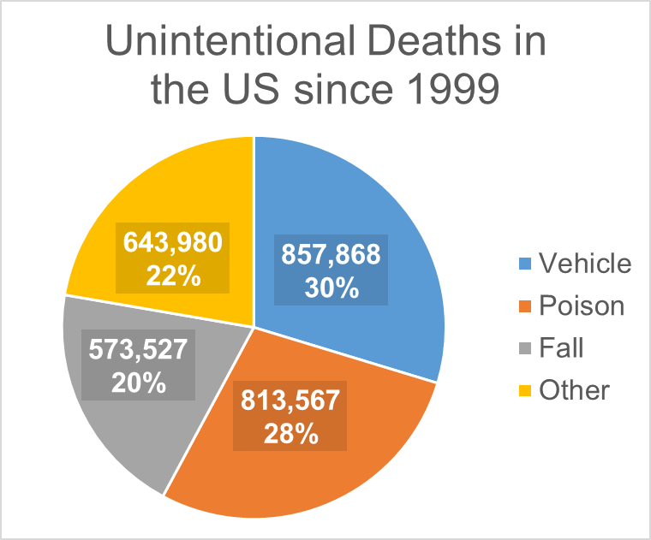
Problem Statement
Falls accounts 20% of unintentional deaths in US [1]
Major source of physical injury for elderly globally [2]
[1] http://wonder.cdc.gov/ucd-icd10.html
[2] https://www.ncbi.nlm.nih.gov/pmc/articles/PMC8347190/

Slide 3
Objectives
Improve the performance of fall detection software working with videos
Tracks multiple people
Functions with low quality video and unusual poses
Fast and works on a live feed
Does not require personal devices and sensors

Slide 4
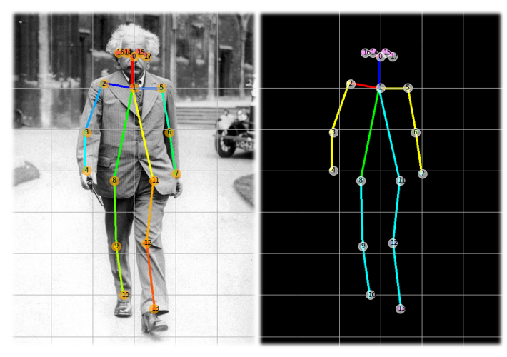
Pose Estimation
Pose estimation programs automatically track the poses of people using key points and bounding boxes
https://towardsdatascience.com/realtime-multiple-person-2d-pose-estimation-using-tensorflow2-x-93e4c156d45f

Slide 5


Previous Literature
Fall Detection using Pose Estimation by Wei Loon Cheng
RMPE (AlphaPose): Regional Multi-person Pose Estimation by Hao-Shu Fang et al.
OpenPose: Realtime Multi-Person 2D Pose Estimation using Part Affinity Fields by Zhe Cao et al.

Slide 6
System Overview
Video
Video Processing
Pose Estimation
Fall Detection
Output

Slide 7
System Overview
Video Processing
Fall Detection
Pose Estimation
Fall Detection
System

Slide 8
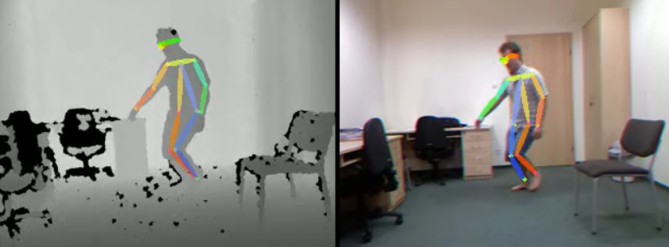
Video Processing and
Pose Estimation
Convert video to useable form
Identify people in video
Assign bounding boxes on each person
Assign key points to joints
Functions despite poor video quality

Slide 9
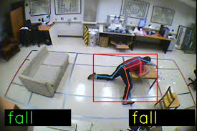
Fall Detection
Trained with fall detection data sets
Distinguish falls from similar motions
Functions with unusual poses
Outputs the number of falls detected
http://ecai2020.eu/papers/519_paper.pdf

Slide 10
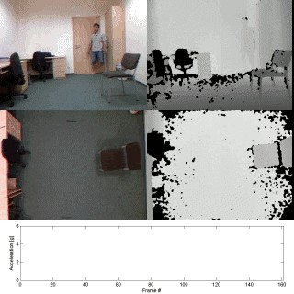
Data Sets
UR Fall Detection Dataset
Sequences of 30 falls and 40 daily activities
Internet Videos
Clips of people falling and normal activities
Personal Datasets
Self-recorded videos
http://fenix.univ.rzeszow.pl/mkepski/ds/uf.html

Slide 11
Execution plan
Completed
In Progress
Not Started
Goal | 9/5 | 9/19 | 10/3 | 10/17 | 10/31 | 11/14 | 11/28
Review Literature on Pose Estimation (Both)
Experiment with Pose Estimation programs (Both)
Improve Performance of Pose Estimation Programs (Nhan)
Study Machine Learning (Justin)
Practice Machine Learning (Justin)
Fall Detection Dataset (Justin)
Train Fall Detection (Justin)

Slide 12
Validation plan
Test | Success Criteria | Methodology | Status | Responsibility
Pose Estimation FPS | Processes videos at 30 FPS | Feed videos at various FPS | Untested | Nhan Nguyen
Fall Detection Accuracy | >90% of falls successfully detected | Use processed videos, compare to labelled dataset | Untested | Justin Haryanto
Whole System Accuracy | >90% of falls successfully detected | Use raw videos, compare to labelled dataset | Untested | Full Team

Slide 13
Status
Researched pose estimation algorithms
Experimented with OpenPose and AlphaPose
AlphaPose is the most useable
Looked into machine learning
Searched for fall detection data sets

Slide 14
Thank You

